Slide 1

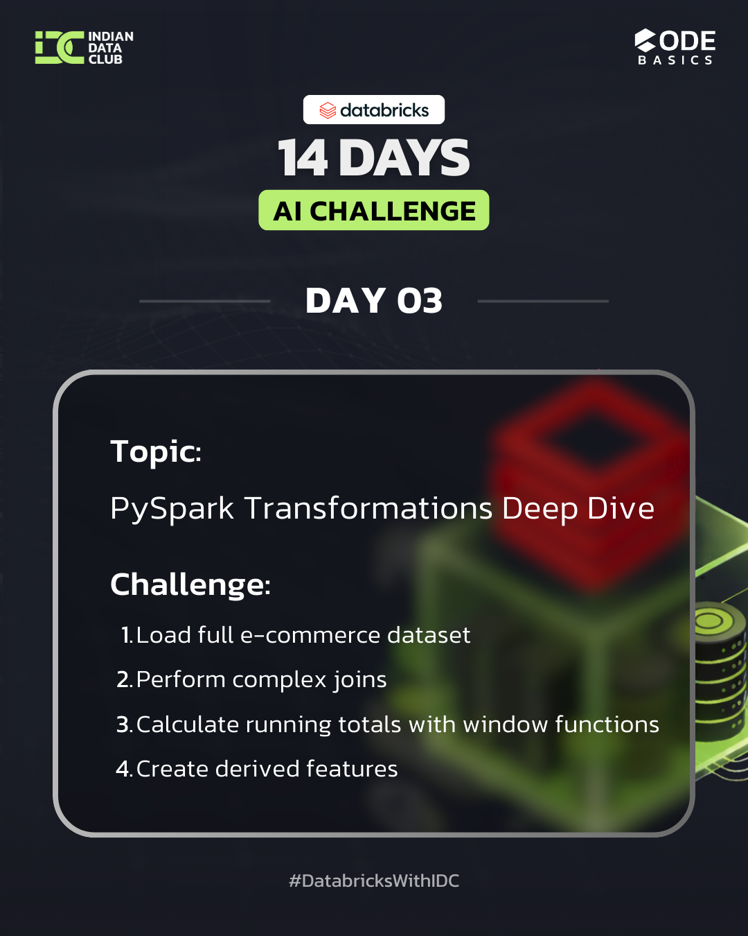
Day 03 – PySpark Transformations in Databricks
Complex Joins, Window Functions & Feature Engineering
Presented by: Ruchi Wange
Notes:
1

Slide 2
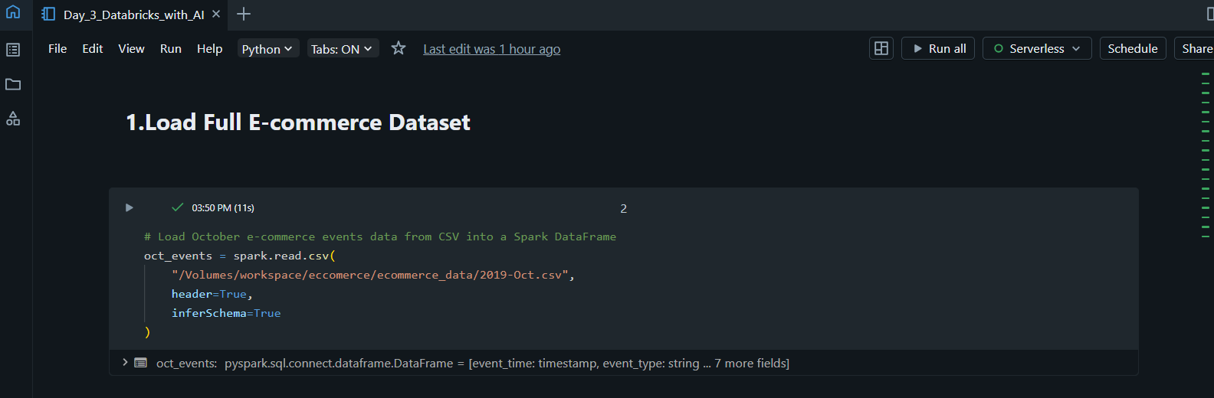
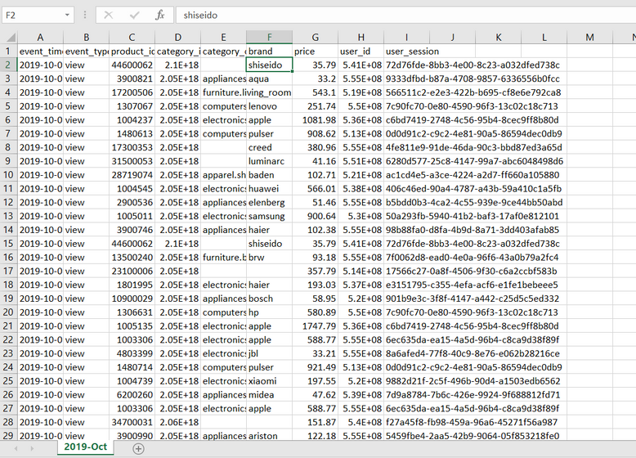
DATASET OVERVIEW
E-commerce Events Dataset
Data Source
Key Columns
October 2019 e-commerce events data loaded from CSV format
event_time, event_type, product_id, user_id, price, brand
Purpose
Analyze user behavior patterns and transaction data
Notes:
2

Slide 3

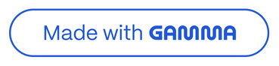
STEP 1
Loading the Dataset
Reading CSV with Spark
Why Use Spark?
Spark handles large datasets efficiently by distributing processing across multiple machines, making it ideal for big data analysis.
Used spark.read.csv() to load the October events file into a DataFrame
Header=True reads column names from first row
InferSchema=True automatically detects data types
Notes:
3

Slide 4

Data Preparation Steps
01
02
03
Create Working Copy
Understand Structure
Handle Missing Data
Renamed oct_events to df for easier reference throughout the analysis
Checked schema, counted records, and identified distinct event types and brands
Replaced null brand values with 'unknown' to prevent errors in analysis
Why handle missing values? Null values can cause errors in joins and aggregations, so replacing them ensures smooth data processing.
Notes:
4

Slide 5

DIMENSION TABLES
Creating Dimension Tables
Dimension tables store descriptive attributes that provide context to fact data.
1
2
3
Products Dimension
Users Dimension
Events Fact Table
Unique product details: product_id, category_id, category_code, brand, price
Unique user information: user_id, user_session
Core interaction data: event_time, event_type, product_id, user_id
Tracks individual users and their browsing sessions
Captures every user action with products
Removed duplicates to ensure one row per product
Notes:
5

Slide 6
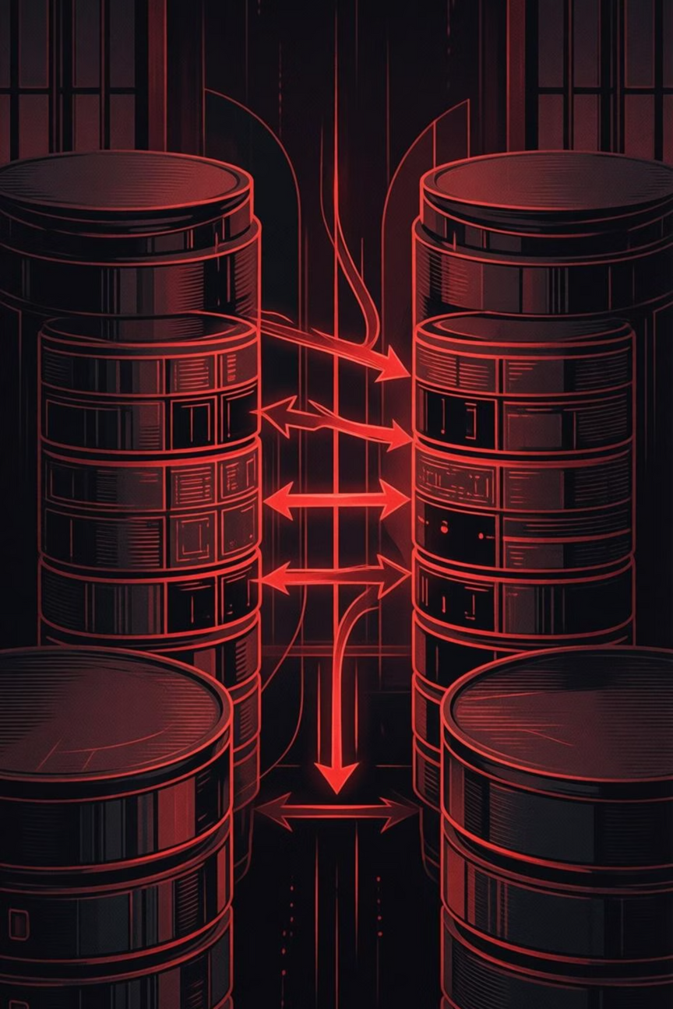



Performing Complex Joins
Events + Products
LEFT JOIN keeps all events while adding product details
Add Users
LEFT JOIN enriches data with user and session information
Final Fact Table
Complete dataset with all dimensions combined
Why LEFT joins? They preserve all event records even if matching dimension data is missing, preventing data loss.
Notes:
6

Slide 7


VALIDATION
Validating Joins
Data Integrity Check
100%
Compared record counts before and after joins to ensure no data was lost during the transformation process.
Data Preserved
Original events count matched final fact table count
All event records maintained
Confirmed all event records were preserved
Verified dimension data was correctly attached
Notes:
7

Slide 8




ADVANCED ANALYTICS
Window Functions
What Are Window Functions?
Per-User Analysis
Perform calculations across rows related to the current row without collapsing the dataset
Partitioned by user_id to calculate metrics for each user separately
Time-Ordered
Running Totals
Ordered by event_time to track user behavior chronologically
Calculated cumulative metrics from first event to current event
Notes:
8

Slide 9
Derived Features
Created new columns to enhance analysis capabilities and provide additional insights.
Event Date
High Price Flag
Purchase Indicator
Extracted date from event_time for daily-level analysis
Binary indicator for products priced above $500
Flag identifying actual purchase events vs. views or carts
Notes:
9

Slide 10

Key Takeaways
1
Data Modeling
Created dimension and fact tables for efficient analysis and querying
2
Complex Joins
Used LEFT joins to combine tables while preserving all event records
3
Window Functions
Applied time-ordered calculations per user for behavioral insights
4
Feature Engineering
Derived new features to enable deeper analysis of user behavior and purchases
Notes:
10

Slide 11
Thank You!!!
Presented by: Ruchi Wange
Notes:
10

